Slide 1
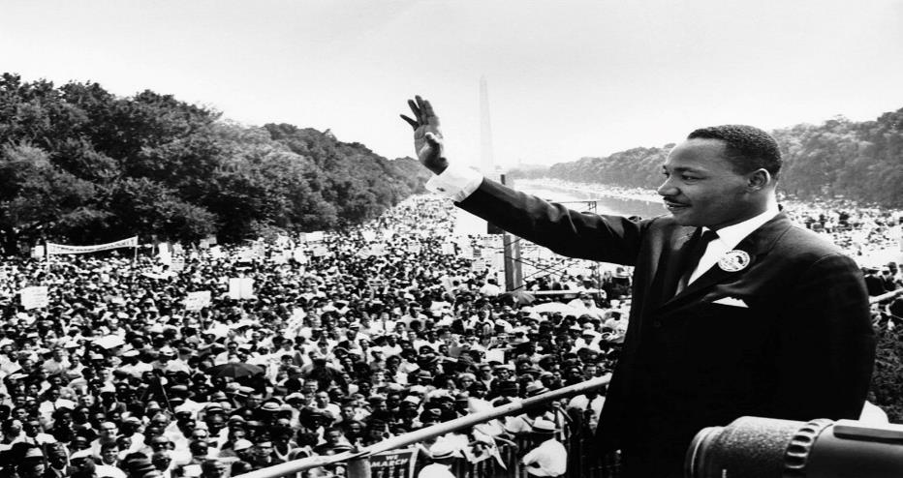
Honoring the life, activism, and service of
DR. MARTIN LUTHER KING JR.
UCM Day of Service 2019

Slide 2
Over 120 hours of service

Slide 3
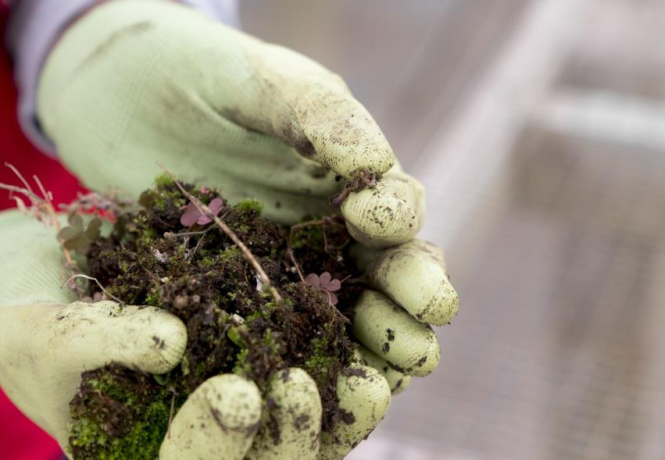

Slide 4
48
Volunteers

Slide 5
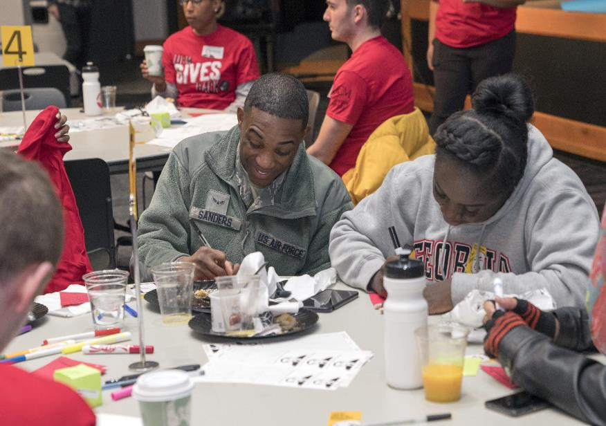

Slide 6
6 Volunteer Sites

Slide 7
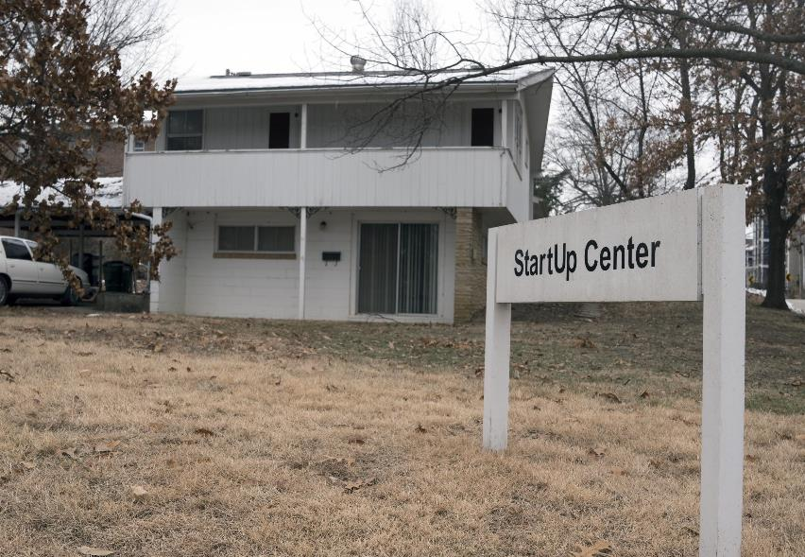

Slide 8
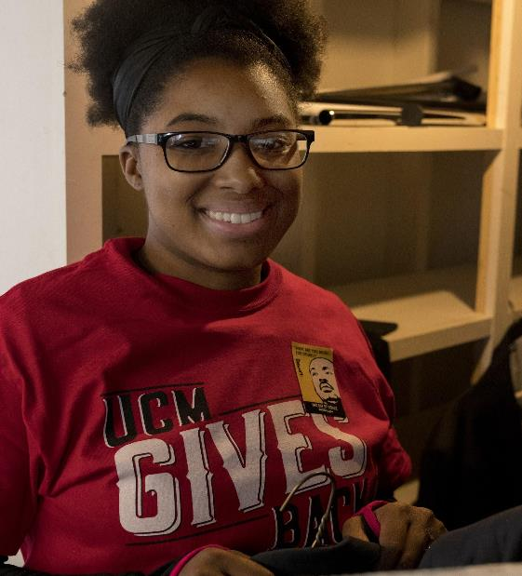

Slide 9
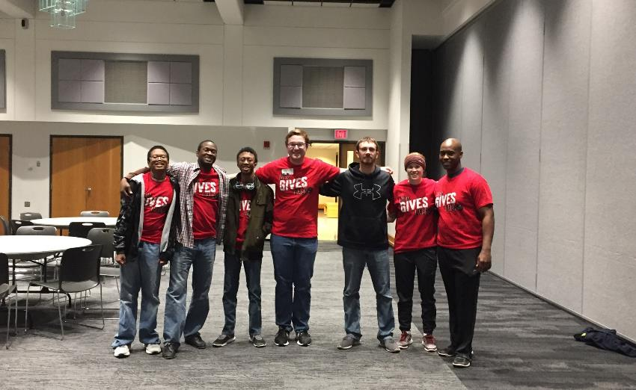

Slide 10
“I have decided to stick to love, hate is too great a burden to bear..”
-Martin Luther King Jr.

Slide 11
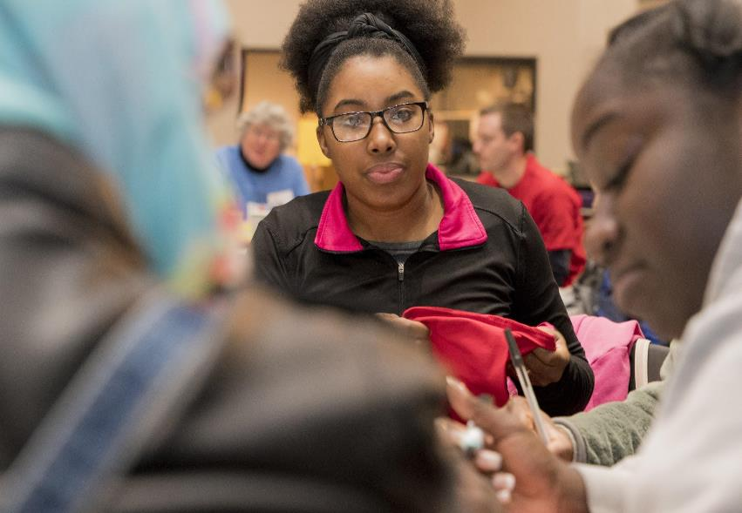

Slide 12
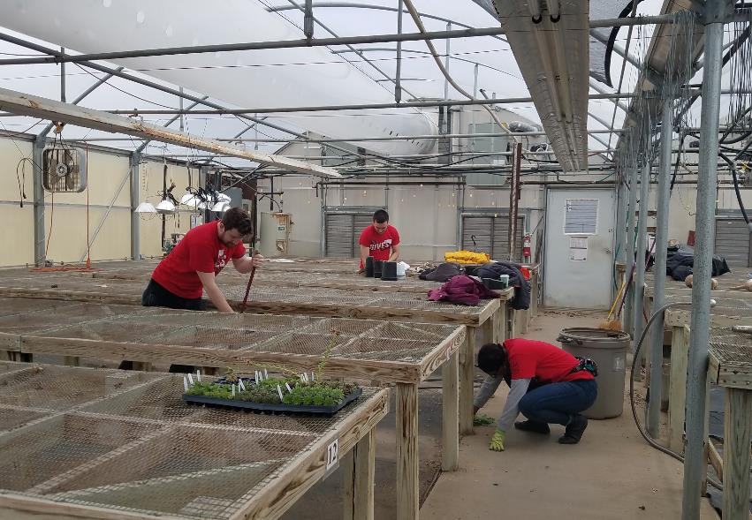

Slide 13
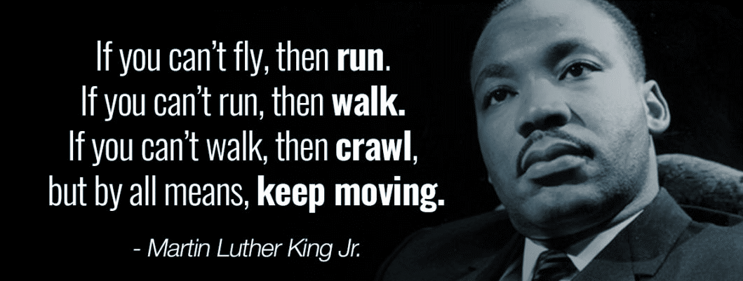

Slide 14
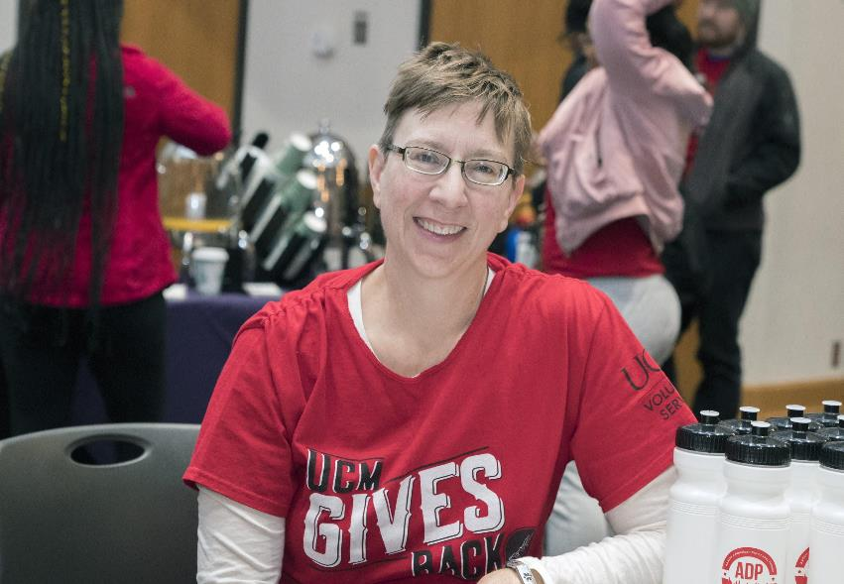

Slide 16
“In the end we will remember not the words of our enemies, but the silence of our friends.”
-Martin Luther King Jr.

Slide 17
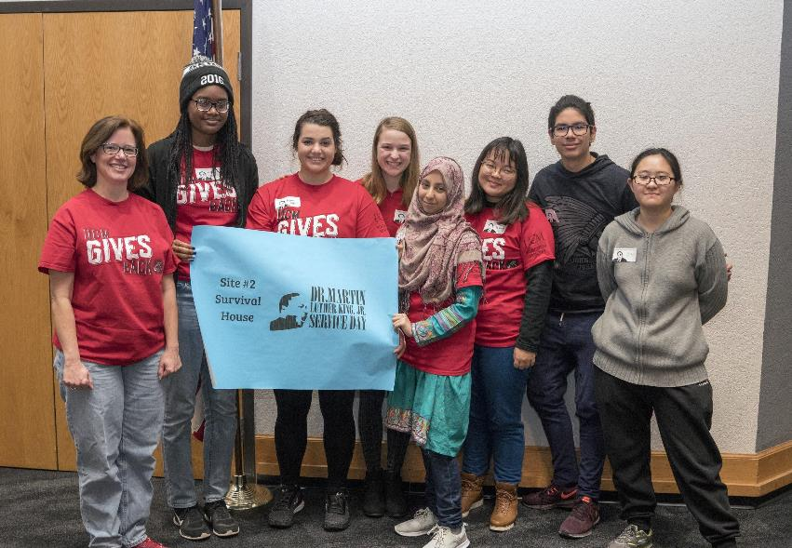

Slide 18
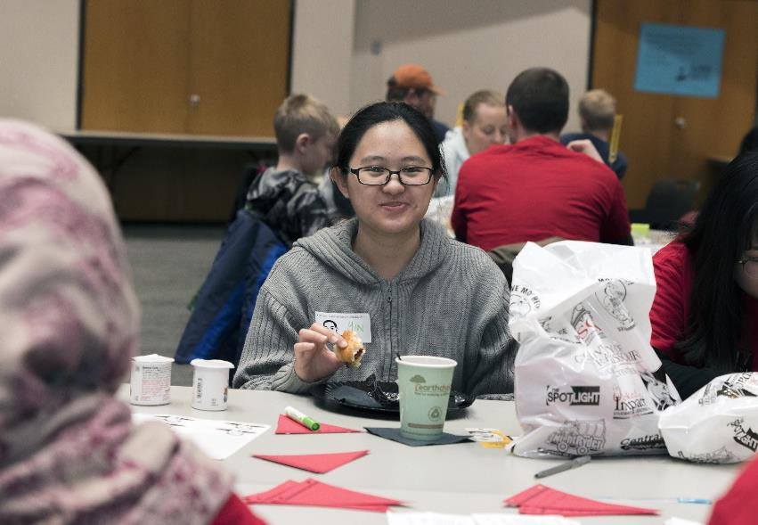

Slide 19
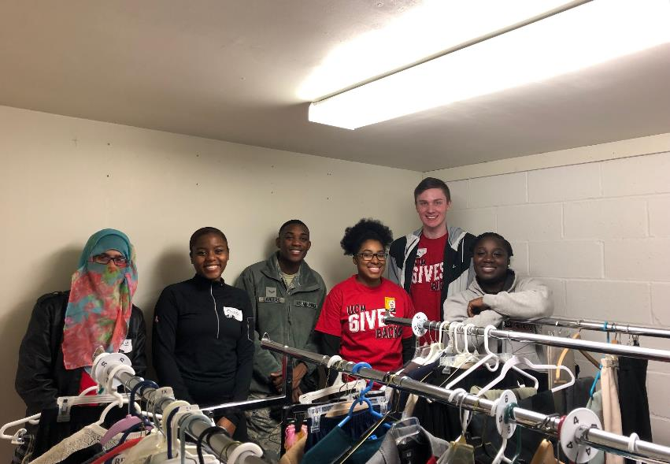

Slide 20
“Life's most persistent and urgent question is, 'What are you doing for others?”
- Martin Luther King Jr.

Slide 22
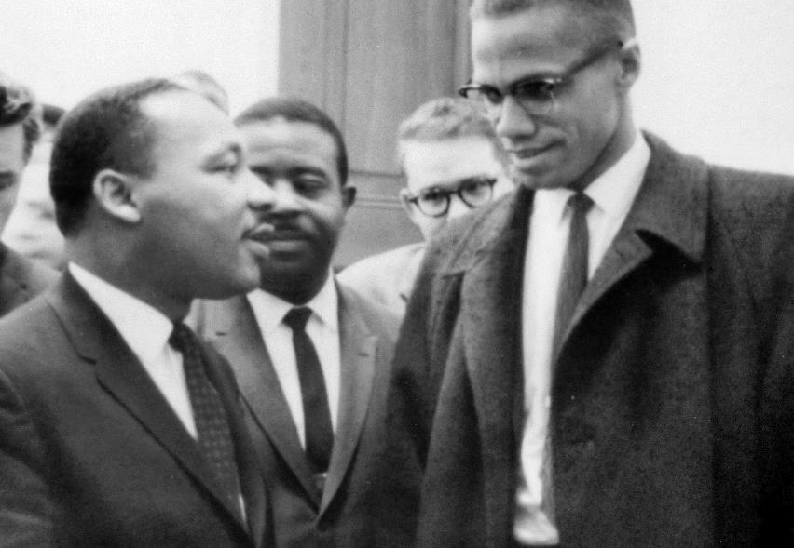

Slide 23
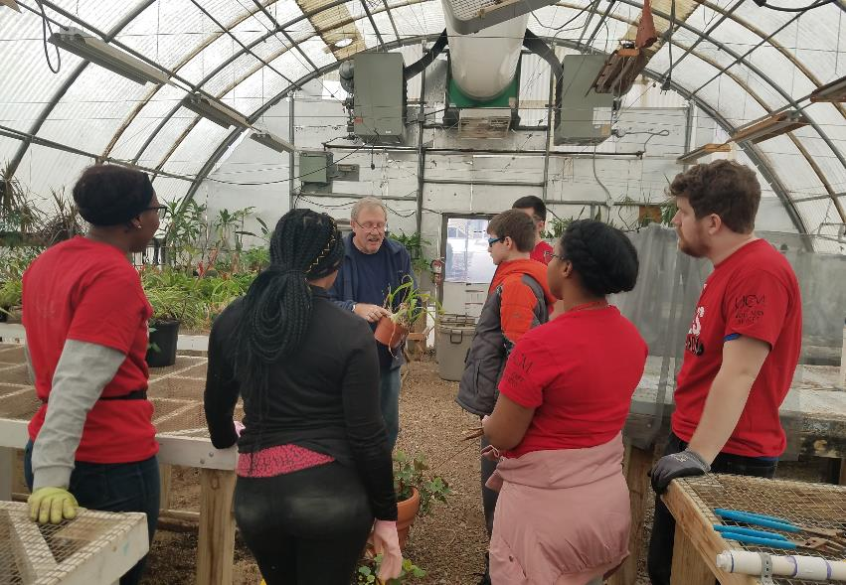

Slide 24
“Forgiveness is not an occasional act. It is a constant attitude”
- Martin Luther King Jr.

Slide 25
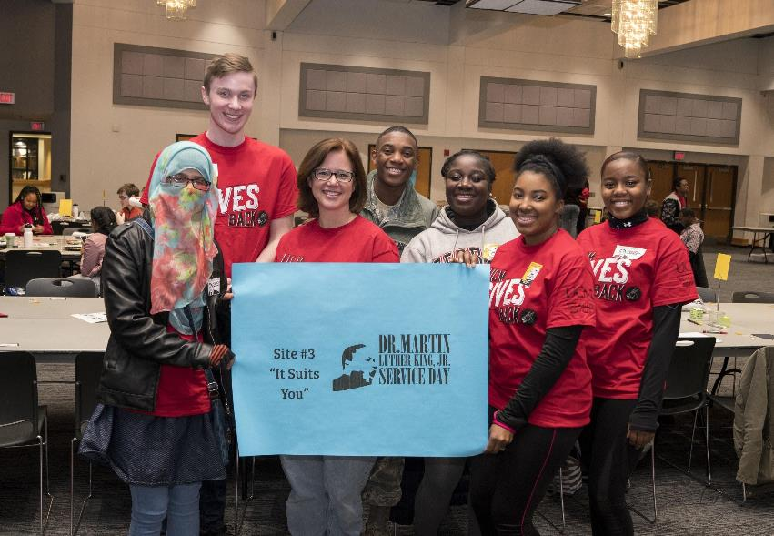

Slide 26
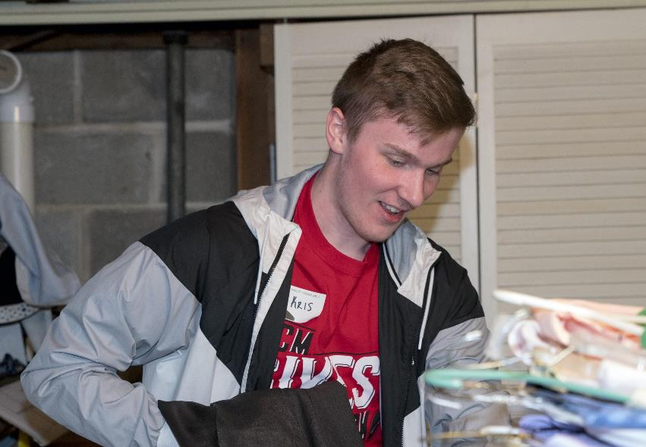

Slide 27
“Change does not roll in on the wheels of inevitability, but comes through continuous struggle.”
- Martin Luther King Jr.

Slide 28
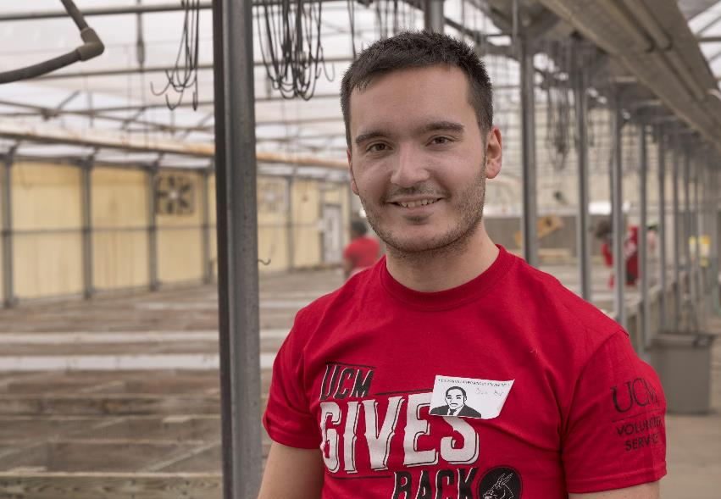

Slide 29
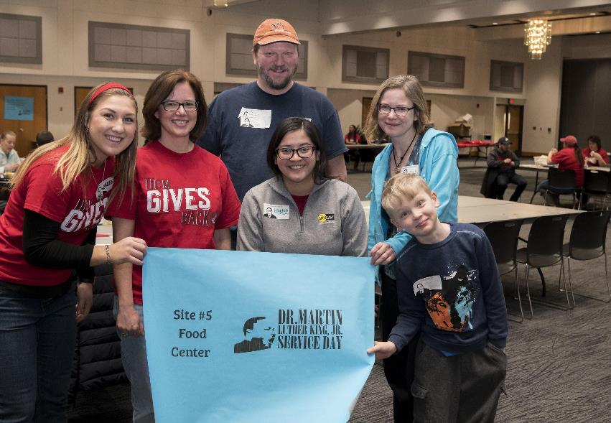

Slide 30
“Injustice anywhere is a threat to justice everywhere.”
-Martin Luther King Jr.

Slide 31
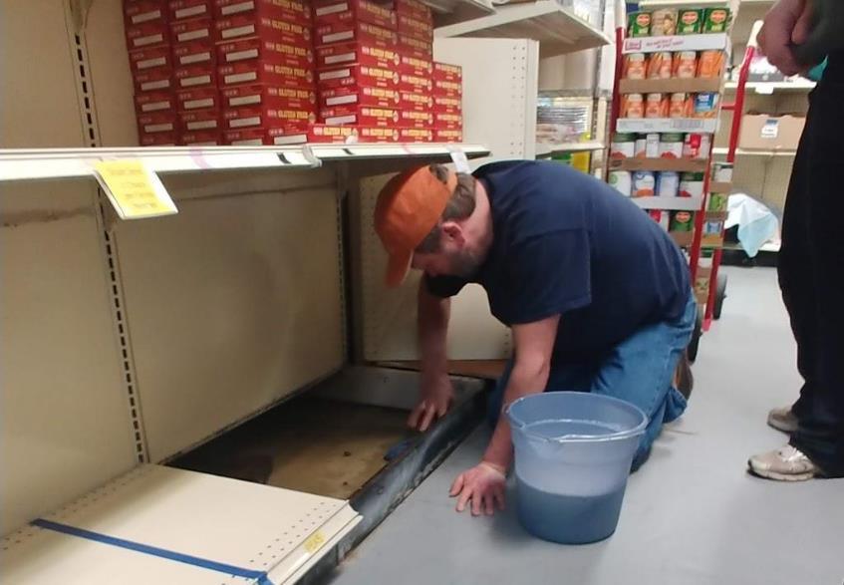

Slide 32
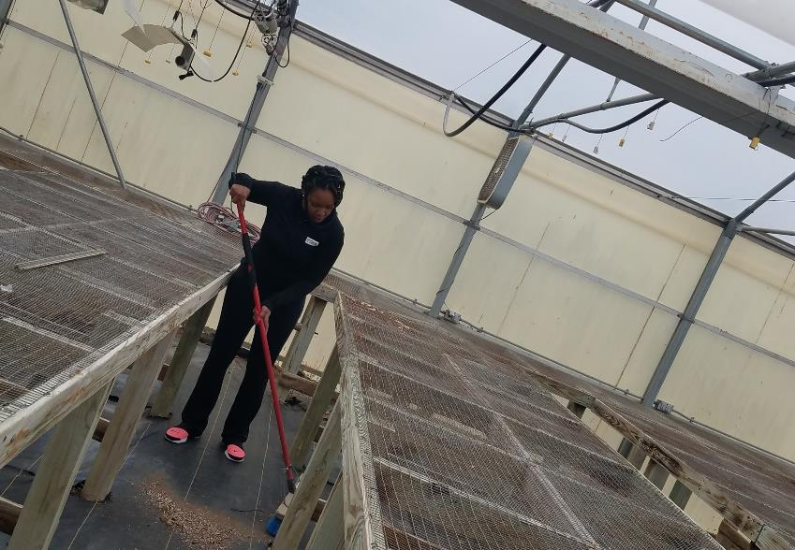

Slide 33
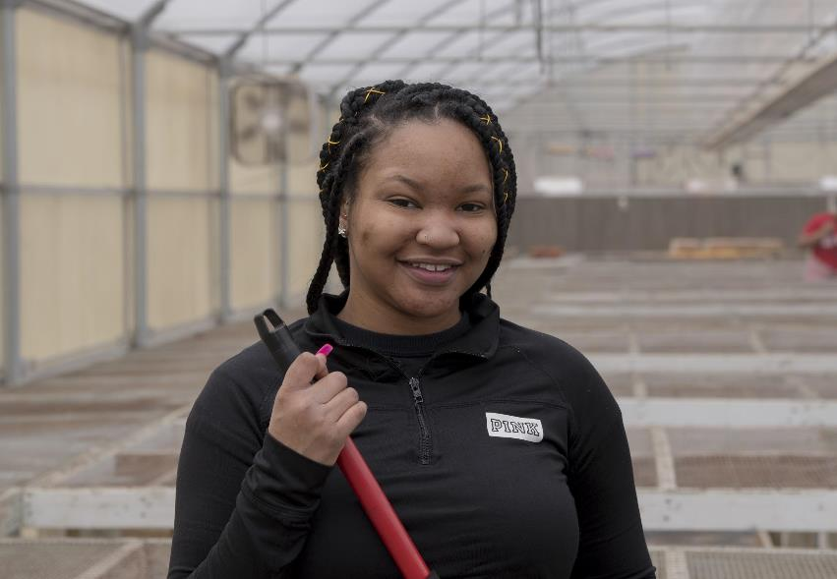

Slide 34
“A genuine leader is not a searcher for consensus but a molder of consensus.”
-Martin Luther King Jr.

Slide 35
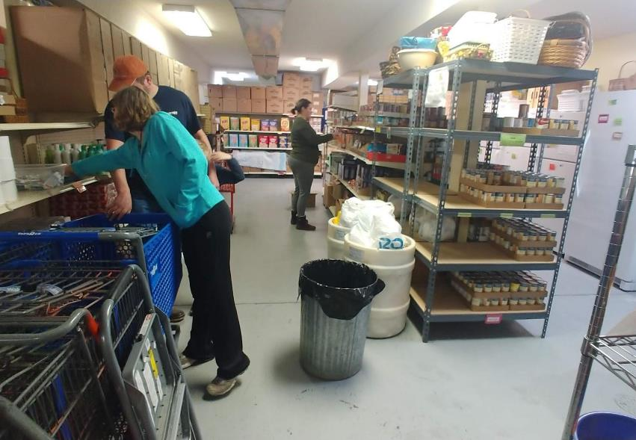

Slide 37
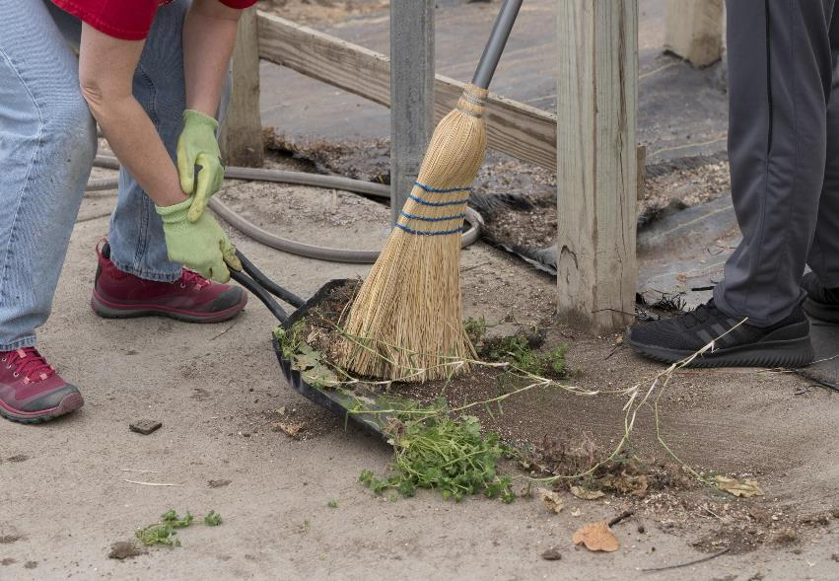

Slide 38
“I have decided to stick with love. Hate is too great a burden to bear.”
- Martin Luther King Jr.

Slide 39
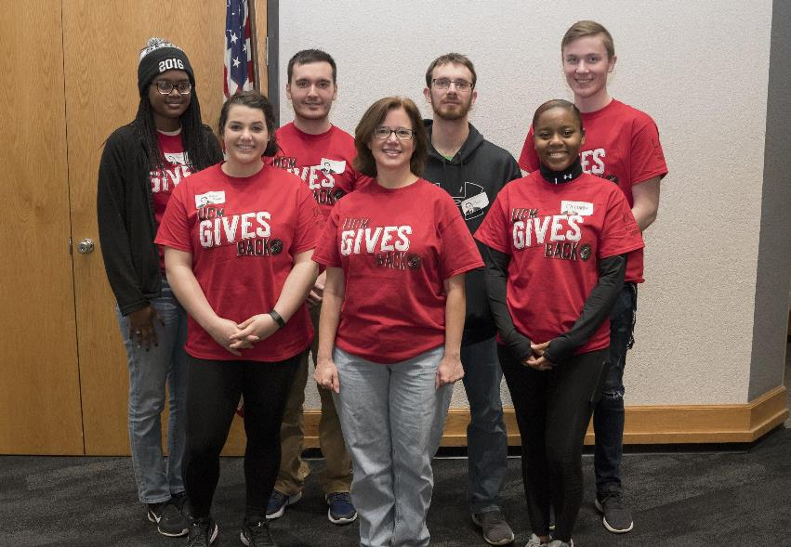

Slide 40
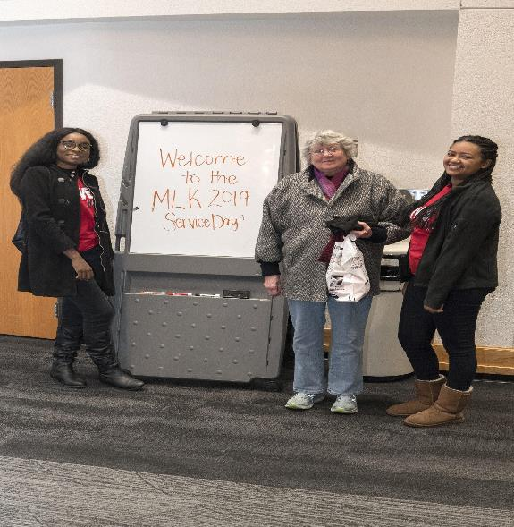

Slide 41
“Life’s most persistent and urgent question is, ‘What are you doing for others?'”
-Martin Luther King Jr.

Slide 42
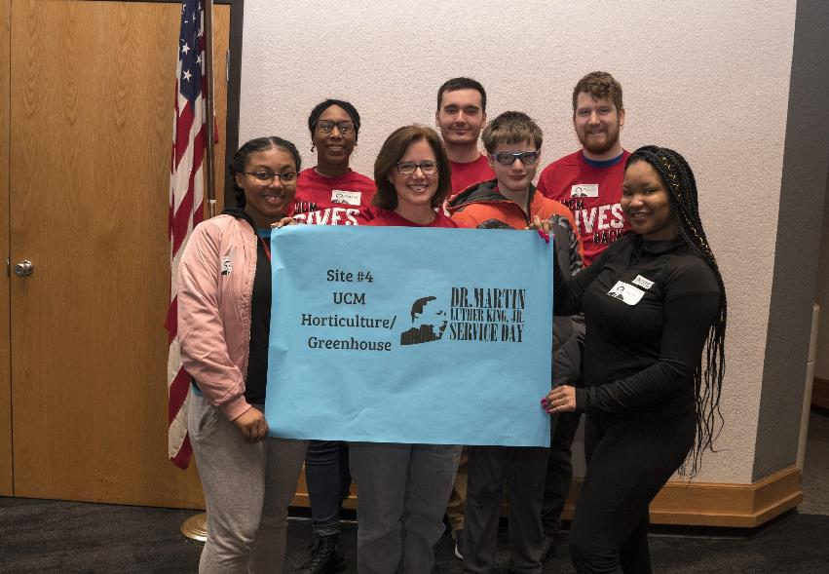

Slide 43
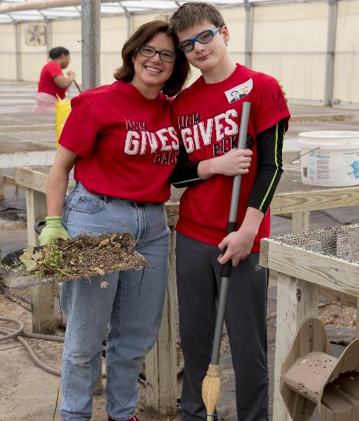

Slide 44
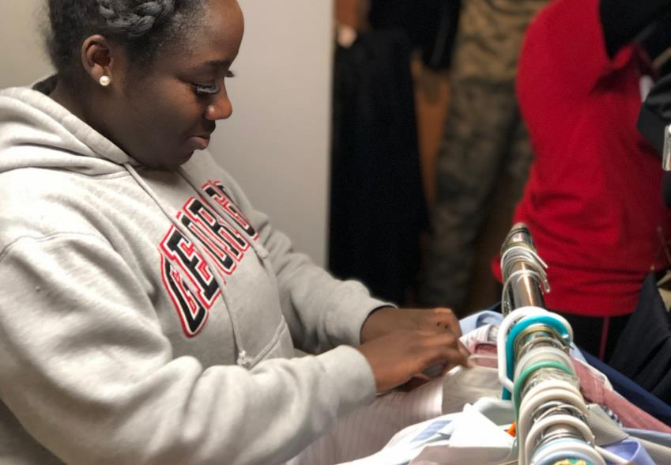

Slide 45
“Our lives begin to end the day we become silent about things that matter.”
- Martin Luther King Jr.

Slide 46
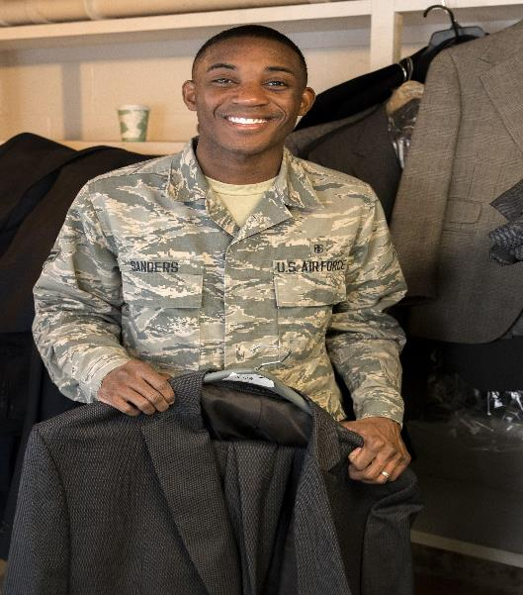

Slide 47
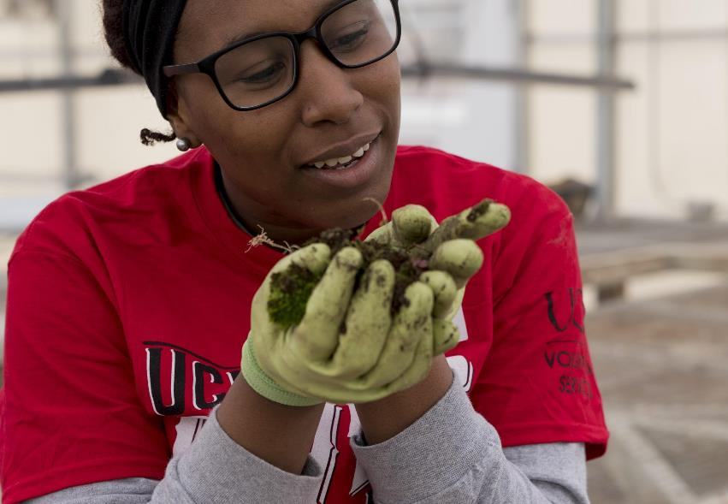

Slide 48
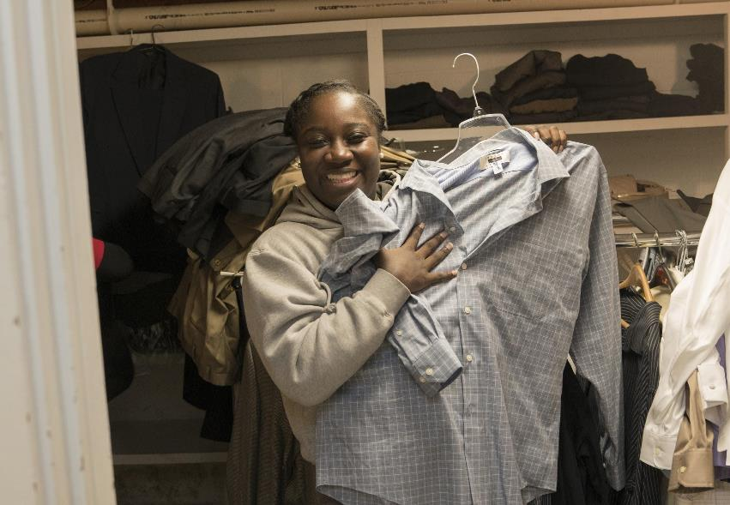

Slide 49
“The ultimate measure of a man is not where he stands in moments of comfort and convenience, but where he stands at times of challenge and controversy.”
-Martin Luther King Jr.

Slide 50
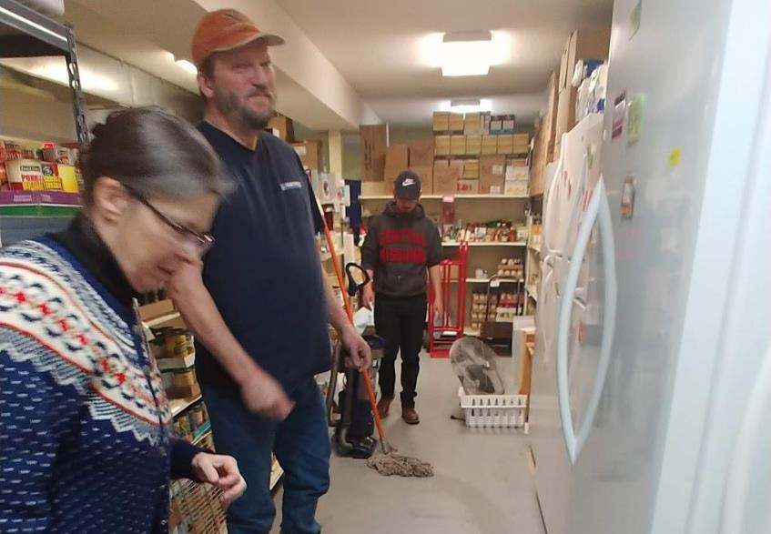

Slide 51
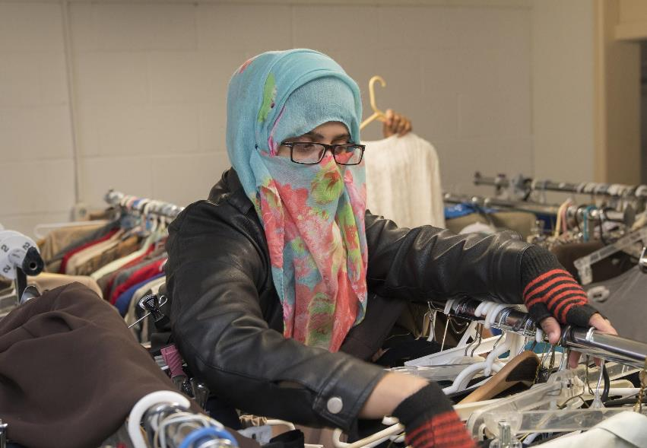

Slide 52
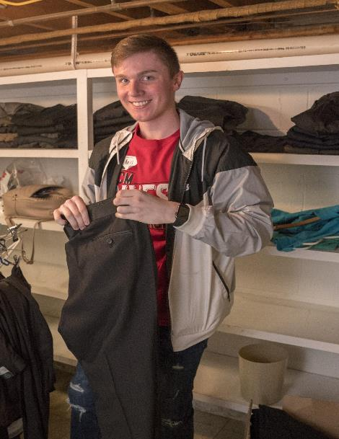

Slide 53
“Change does not roll in on the wheels of inevitability, but comes through continuous struggle.”
-Martin Luther King Jr.

Slide 54
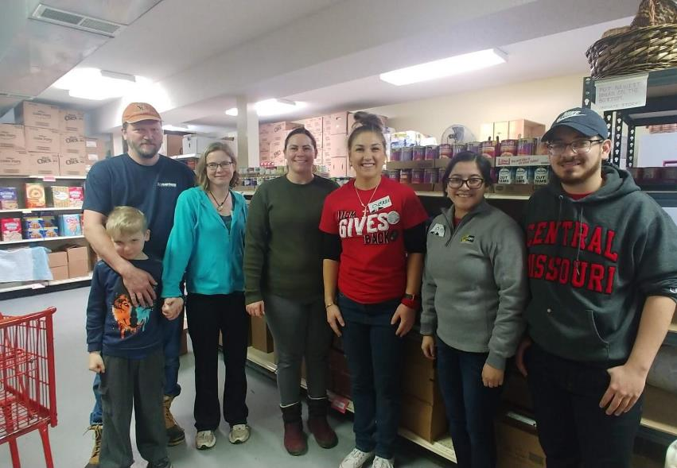

Slide 55
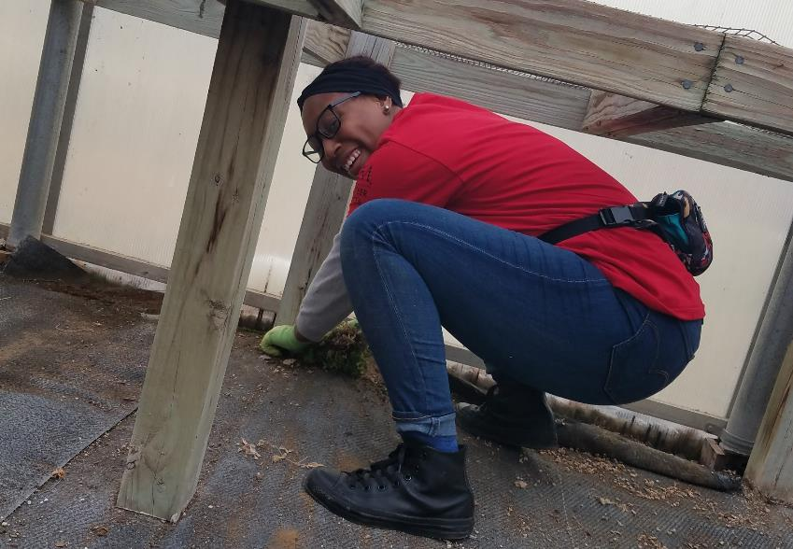

Slide 56
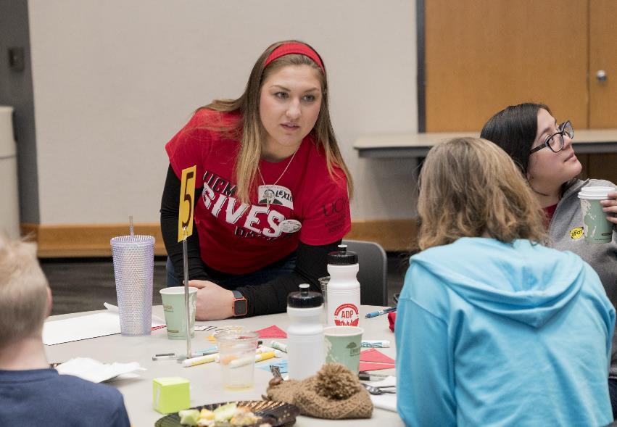

Slide 57
“Whatever affects one directly, affects all indirectly. I can never be what I ought to be until you are what you ought to be.”
-Martin Luther King Jr.

Slide 58
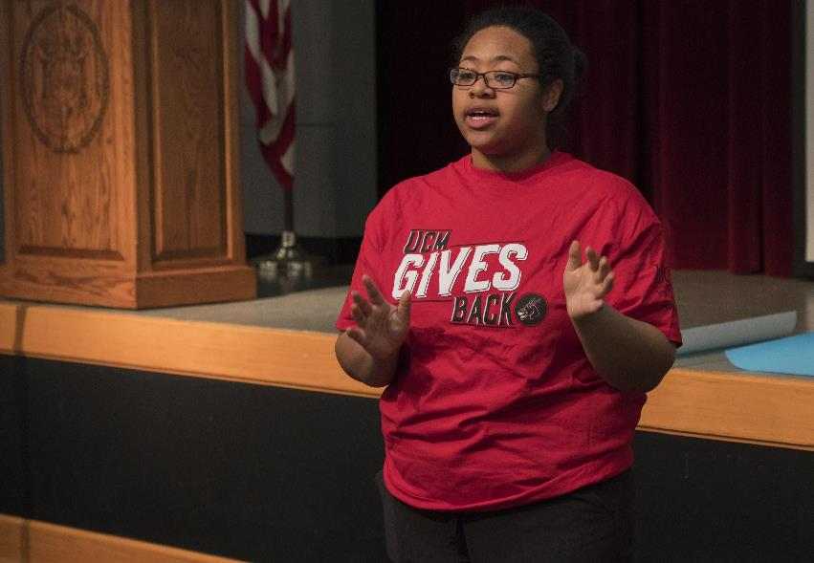

Slide 59
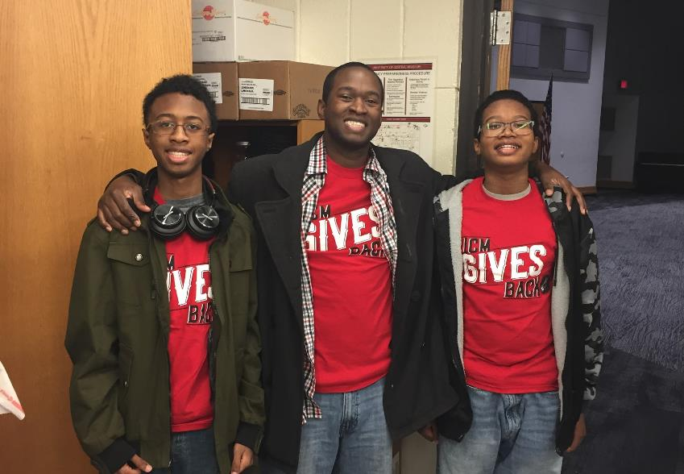

Slide 60
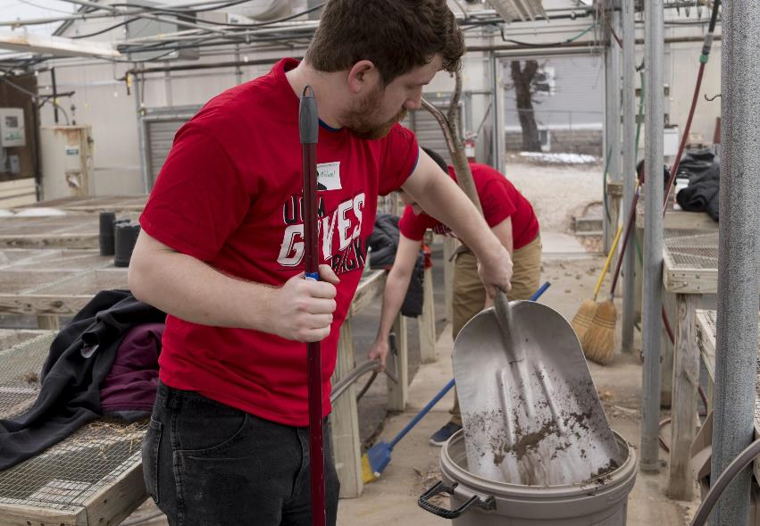

Slide 61
“There comes a time when one must take a position that is neither safe, nor politic, nor popular, but he must take it because conscience tells him it is right.”
-Martin Luther King

Slide 62
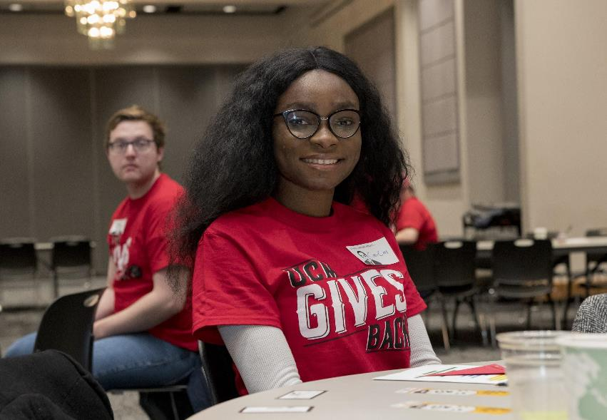

Slide 63
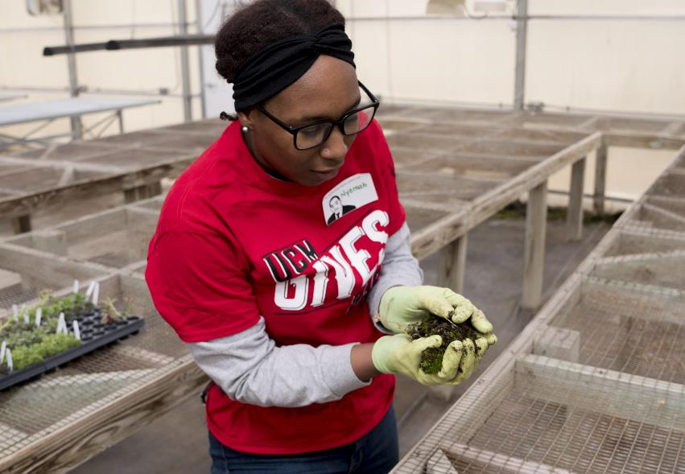

Slide 64
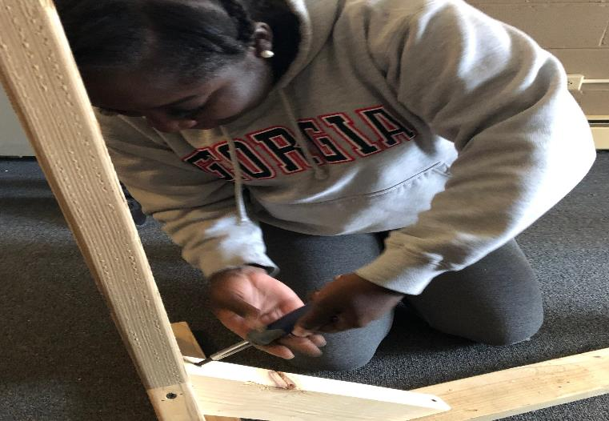

Slide 65
“If you can’t fly then run, if you can’t run then walk, if you can’t walk then crawl, but whatever you do you have to keep moving forward.”
-Martin Luther King Jr.

Slide 66
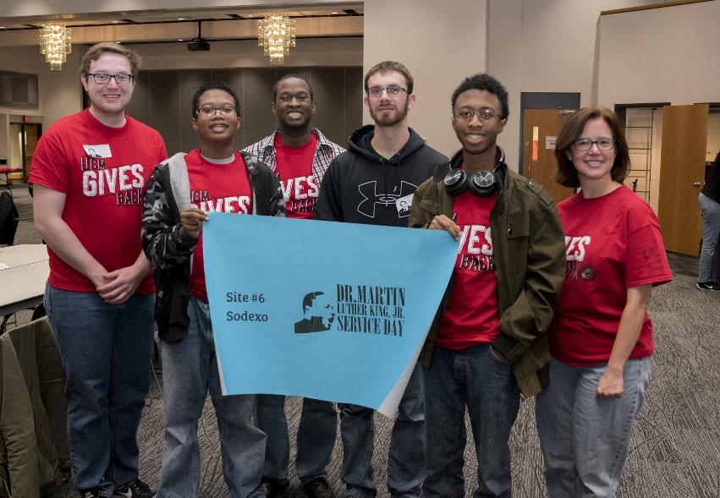

Slide 67
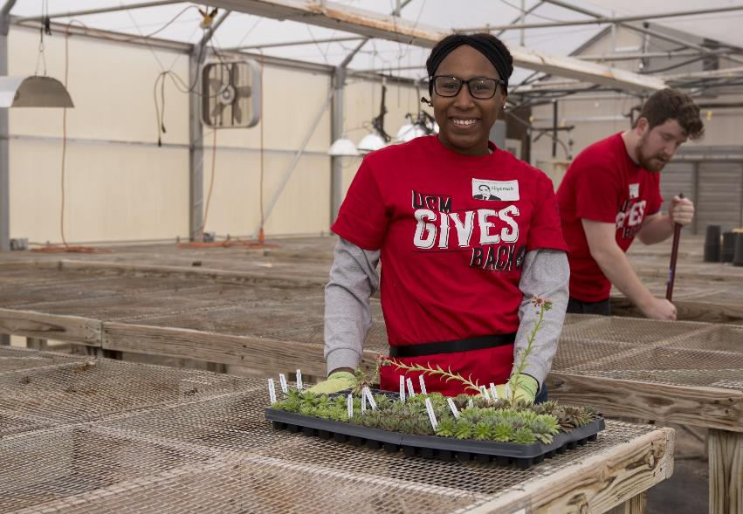

Slide 69
“Let no man pull you low enough to hate him.”
-Martin Luther King Jr.

Slide 70
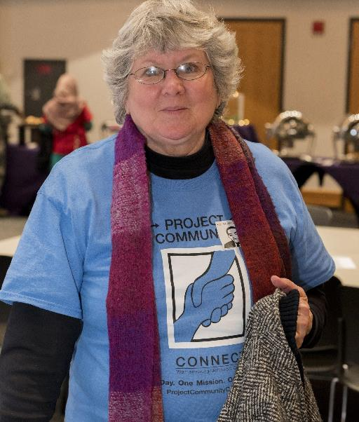

Slide 71
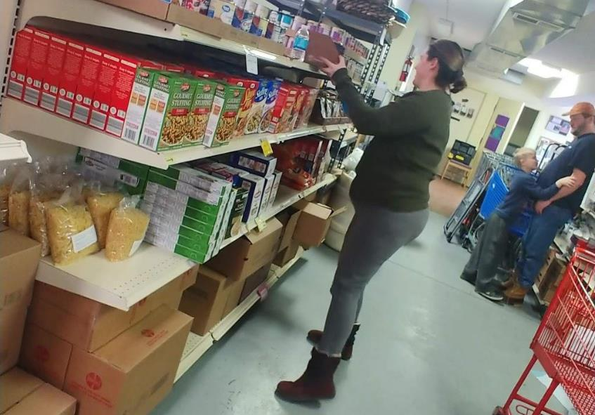

Slide 72
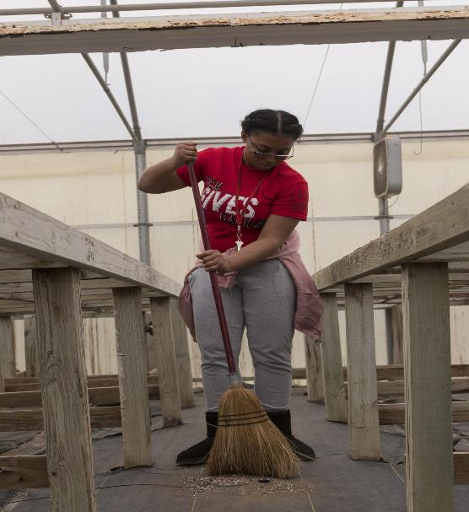

Slide 73
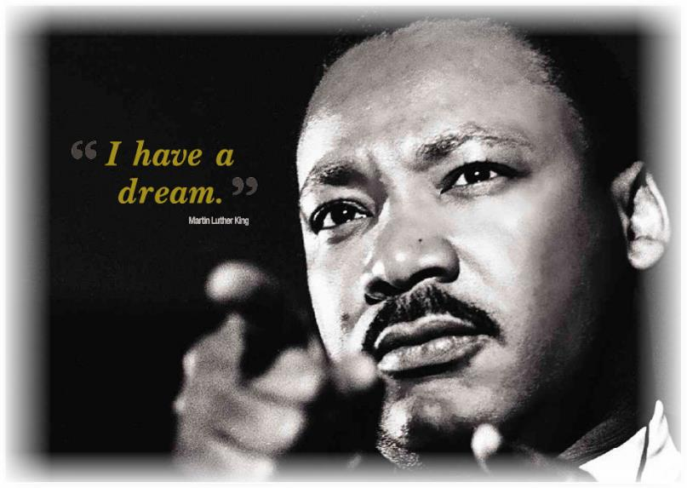

Slide 76
Special thank you to everyone who participated and made contributions to the MLK Day of Service.
Always remember to lead with love.

